Slide 1
MassFUSIOn 2.0
Features & Requirements

Slide 2
AGENDA
Introduction​
Primary goals
Product Perspective/Features
Design Approach
​Use Cases​

Slide 3
introduction
The purpose of this document is to detail the requirements for a “MassFusion version 2.0” software. This formal document will be used to define the problem scope, proposed solution to the problem and intended use of the solution.

Slide 4





PRIMARY GOALS
.
.
.
.
.
A web- based MassFusion 2.0
digital tagging of each load cell in the production flow through serial number and bar code marking together with bar code scanning
Application to manage the flow of load cell manufacturing ensuring quality and control
digital connectivity and integration with enterprise ERP and CRM applications to enhance productivity
quality tracking and reporting capabilities

Slide 5


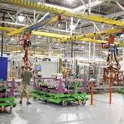


Product Perspective
Collection of Services
Registration MANAGER
MODeL MANAGER
PRODUCT MANAGER​
User Administration
Model design and engineering doc versions
Production Workflow

Slide 6

Product perspective
Platform : Web Based
Features
* User management
* Model Management
* Production Management
Creating and deletion of users
assignment of roles and functions.
Creating and Editing of Models,
Creating and Revision of Documents,
Addition and Editing of Capacities
Batch Tracking***
Product History***
Automatic Analysis***
Engineering interfaces to Production Drawing and Procedures*
Reports
Event Reports
Overview Reports
VCap Reports
Loadcell Serial Number Generation
Heat Treating
Perform Chrome inspection,
BarCode Label Printing***
Gauging
Gauging Inspection
Wiring
Cabling
Trimming (Zero balance)***
Exercise
Add Resistor
Sealing
Auto Verification(Initial and Final
Packaging
Shipping
Finished Product Electronic List
Generation of edocuments for QuickBooks/Integration***

Slide 7

USE CASES
Possible Interactions

Slide 8
MODeL MANAGER use cases
Got the Specs ?
MODeL MANAGER
Model design and engineering doc versions

Slide 9
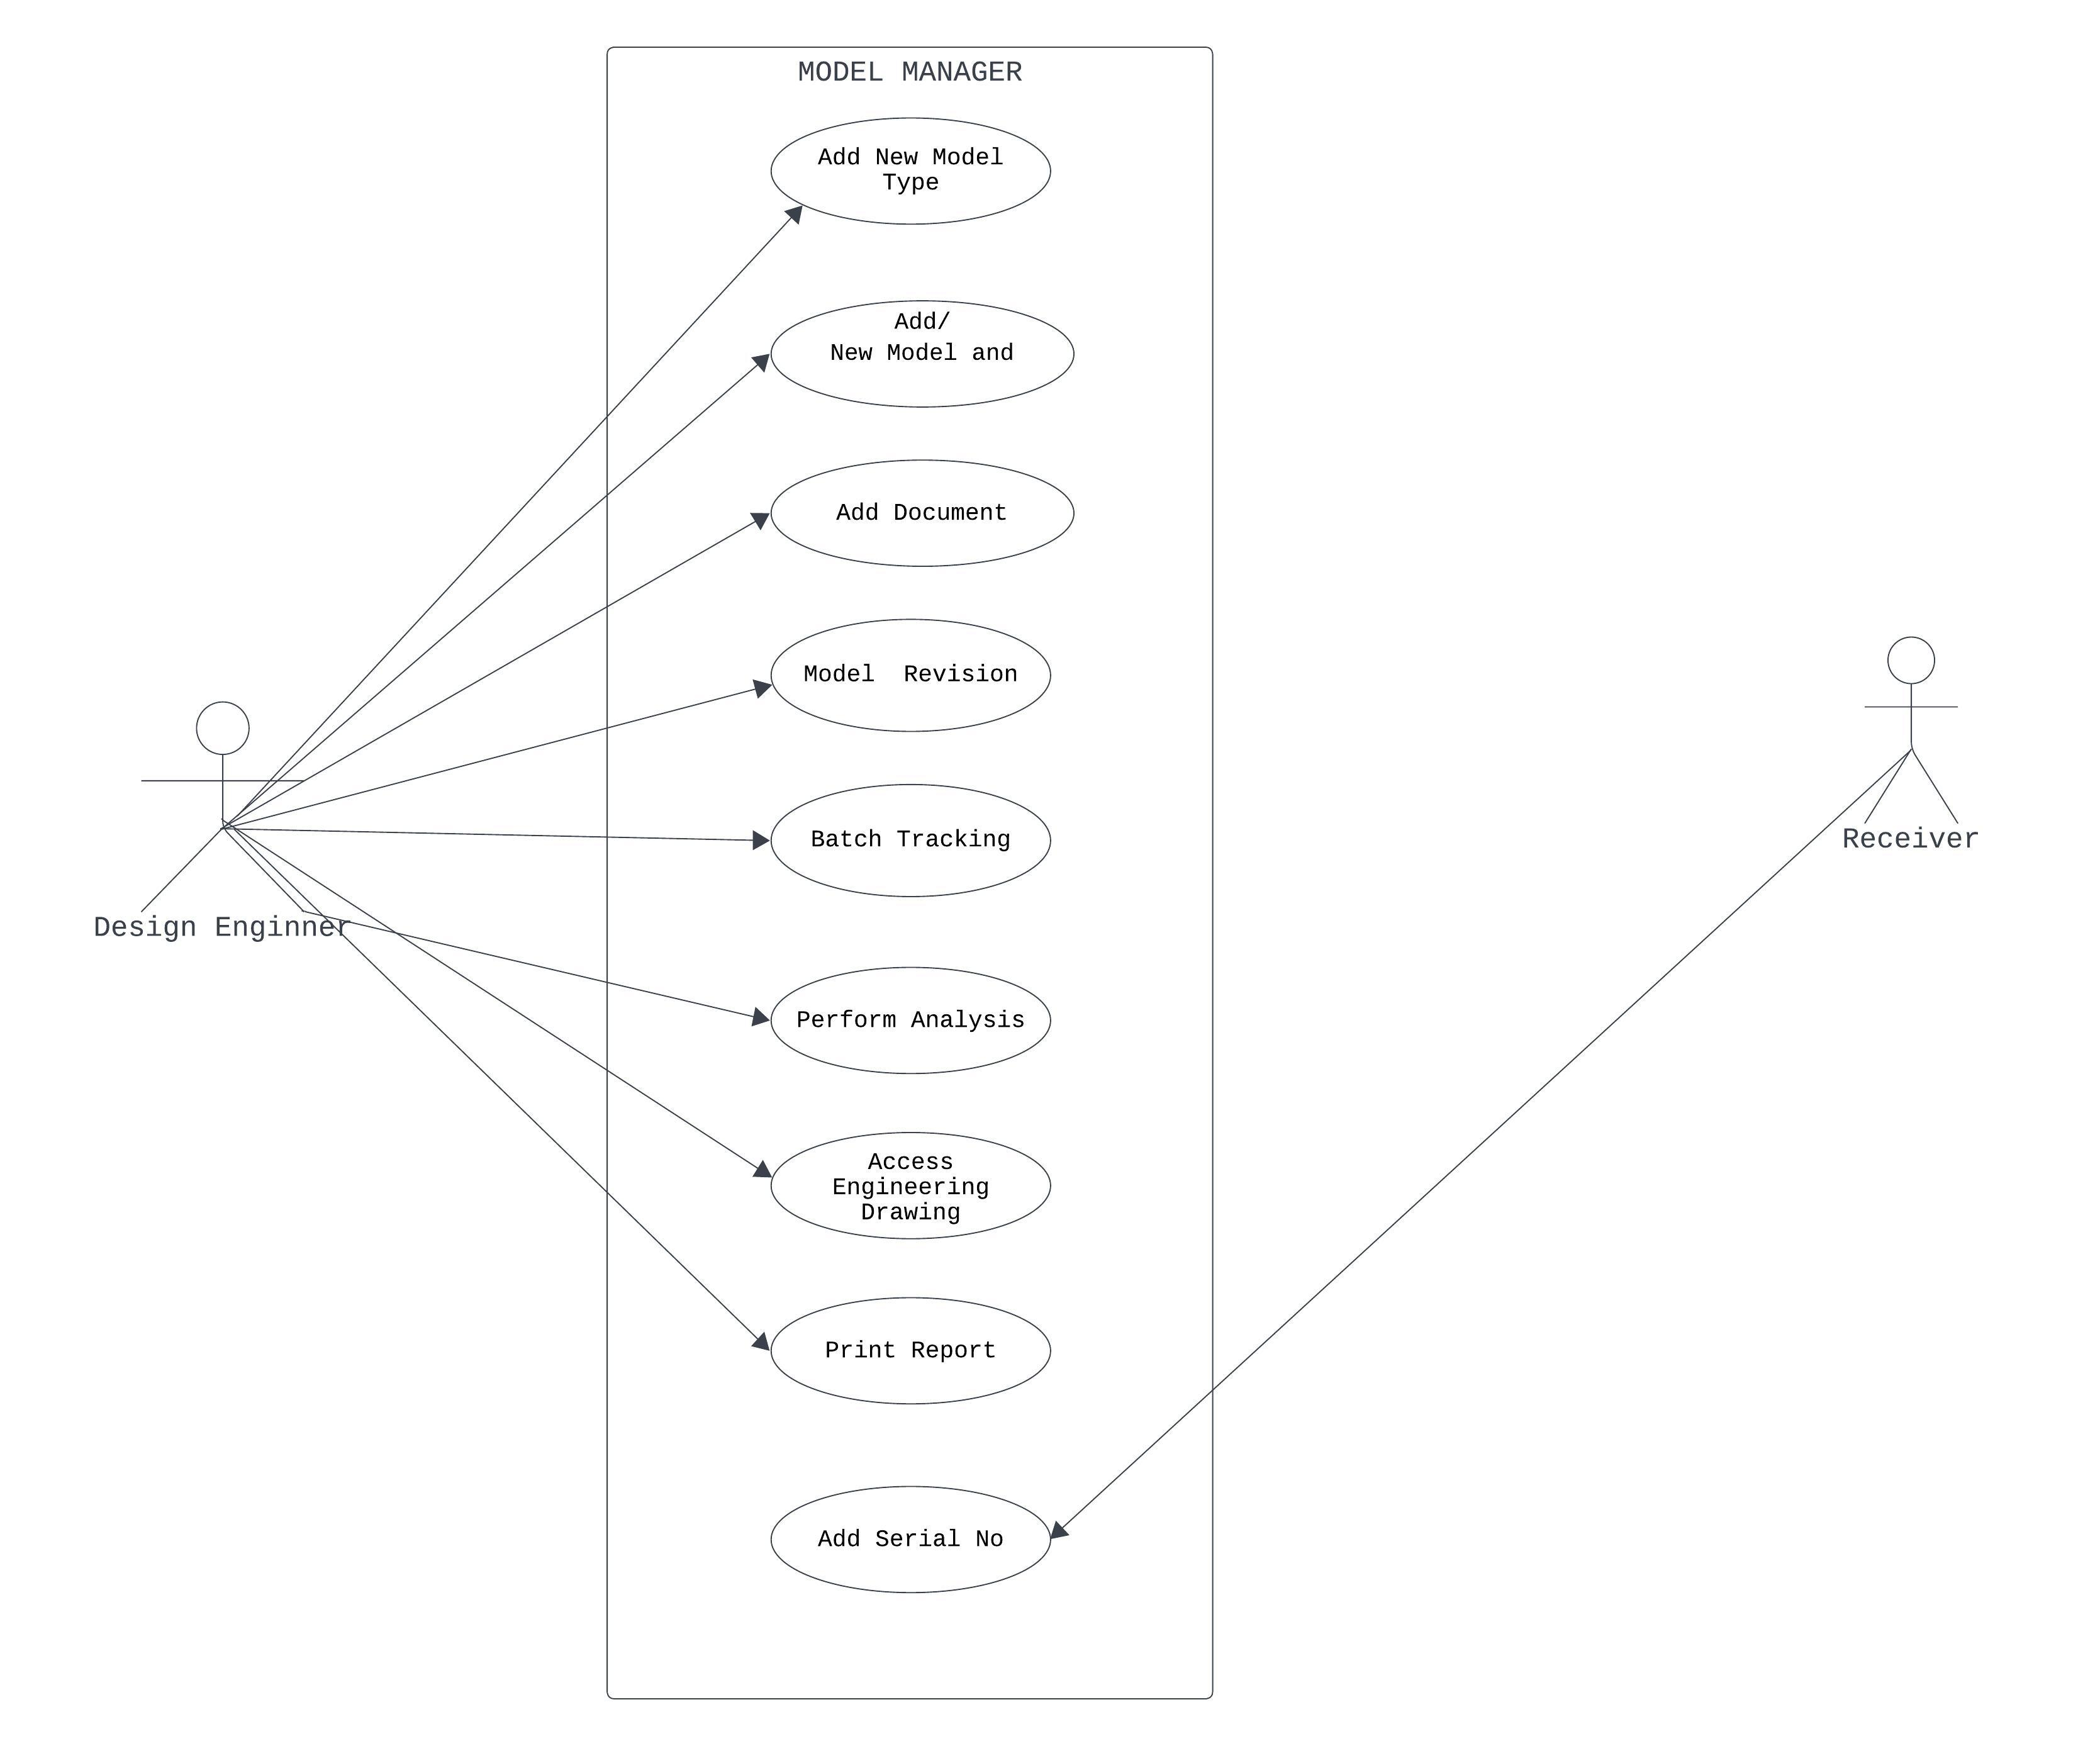
MODEL MANAGEMENT

Slide 10
CASE 1
Add New Model Type ***
Use Case | Model Management- New Model Type
Actors | Design Engineer
Tasks | Add a new model type to the system (eg Axle Pad, Ultra Slim etc) .

Slide 11
CASE 2
New Model and Capabilities
Use Case | Model Management- New Model and Capabilities
Actors | Design Engineer
Tasks | Add a new model to the system Define model capacities Define test parameters (number of points, testing/measuring range, etc) Define nominal output

Slide 12
CASE 3
Add Document
Use Case | Model Management- Add Document
Actors | Design Engineer
Tasks | Select an existing model Add first version of a document

Slide 13
CASE 4
Model Revision
Use Case | Model Management- Model Revision
Actors | Design Engineer
Tasks | Select an existing model Select an existing document Add a new revision of selected document Associate a change order with the new revision Specify which capacities of the model the revision pertains to

Slide 14
CASE 5
Batch Tracking***
Use Case | Model Management– Batch Tracking
Actors | Design Engineer
Tasks | Select an existing model Select an existing Batch Number Perform Tracking and searching for purposes of reporting and analysis

Slide 15
CASE 6
Perform Analysis***
Use Case | Model Management– Perform Analysis
Actors | Design Engineer
Tasks | Select an existing model Select other related parameters Perform Automatic Analysis – statistical analysis for data generated during AV

Slide 16
CASE 7
Access Engineering Drawing
Use Case | Model Management– Access Engineering Drawing
Actors | Design Engineer
Tasks | Viewing of design documents for production (implemented in Massfusion 1.0 upgrades)

Slide 17
CASE 8
Assign Serial No
Use Case | Model Management– Assigning Serial No
Actors | Receiver
Tasks | Select an existing model Select an item quantity Enter the certification number of the steel , assign a BatchNo *, and other summary text Accept and confirm parameters Note: Batch of load cells is a grouping/set of shells received into Massload from which serial numbers will be generated

Slide 18
PRODUCTION MANAGEMENT use case
Let’s build it
PRODUCT MANAGER​
Production Workflow

Slide 19
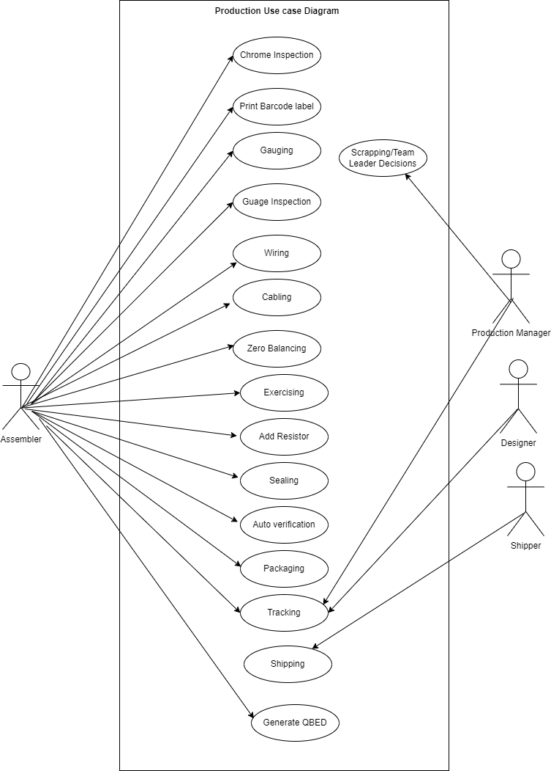
PRODUCTION MANAGENT
Selection of loadcell at any stage shall be done by with Barcode scanner with keyboard backup alternative
Login shall be done with Barcode scanner

Slide 20
CASE 1
Print BarCode Label***
Use Case | Production – Printing of Barcode Label
Actors | Assemblers
Tasks | Select a product or a batch Print Label
PreCondition | BarCode Printer Must be connected

Slide 21
CASE 2
Production – Production – Chrome, Gauging, Gauge inspection, Wiring, Cabling, Zero Balancing*, Exercise, Add Resistor and Sealing
Use Case | Production – Production – Chrome, Gauging, Gauge inspection, Wiring, Cabling, Zero Balancing*, Exercise, Add Resistor and Sealing
Actors | Assemblers
Tasks | Select a product in the user’s current production stage View latest versions of design documents relevant to the user’s current production stage Pass the product onto the next production stage (or fail if applicable: Perform Non Conformance Notification )

Slide 22
CASE3
Initial Verification
Use Case | Production – Initial Verification
Actors | Assemblers
Tasks | Select an existing product in the “Initial Verification” stage of production. Install the indicated test jig onto the tester. Install the chosen product onto the test jig. Commence automated testing. Pass the product onto the next production stage, or fail if the results do not fall within the tolerance values specified by the model design, perform Non Conformance Notification
PreCondition | Agilient Multimeter, MoreHouse and RMC Tools must be connected

Slide 23
CASE 4
Final verification
Use Case | Production – Final Verification
Actors | Assemblers
Tasks | Select an existing product in the “Final Verification” stage of production. Install the indicated test jig onto the tester. Install the chosen product onto the test jig. Commence automated testing. Pass the product onto the next production stage, or fail if the results do not fall within the tolerance values specified by the model design.
PreCondition | Agilient Multimeter, MoreHouse and RMC Tools must be connected

Slide 24
CASE 5
Non Conformance Notification
Use Case | Production – Non-Conformance Notification
Actors | Assembler, Production Manager
Tasks | Assembler performs inspection or verification on the product. The product fails. A notification record is inserted into the database. Notification is presented to the Production Manager via the software.*

Slide 25
CASE 6
Packaging
Use Case | Production – Packaging
Actors | Assembler, Production Manager
Tasks | User Select Product Print Certificate Print Warranty

Slide 26
CASE 7
Generate QuickBooks Electronic Document***
Use Case | Production – Generate QuickBooks Electronic Document
Actors | Assembler
Tasks | Select a product or Products Generated electronic document

Slide 27
CASE 8
Scrapping/Team Leader Decision
Use Case | Production – Non-Conformance Notification
Actors | Production Manager
Tasks | Assembler performs inspection or verification on the product. Select a product of interest Move product to desire stage OR Add a comment Scrap product A notification record is inserted into the database.

Slide 28
CASE 9
Tracking
Use Case | Production – Tracking
Actors | Assembler, Production Manager, Designer,
Tasks | Select a product Type search criteria Search System should display product details ,current stage and events journey

Slide 29
CASE 10
Shipping
Use Case | Production – Shipping
Actors | Shipper
Tasks | Connect with QuickBooks Select product Select customers Ship

Slide 30
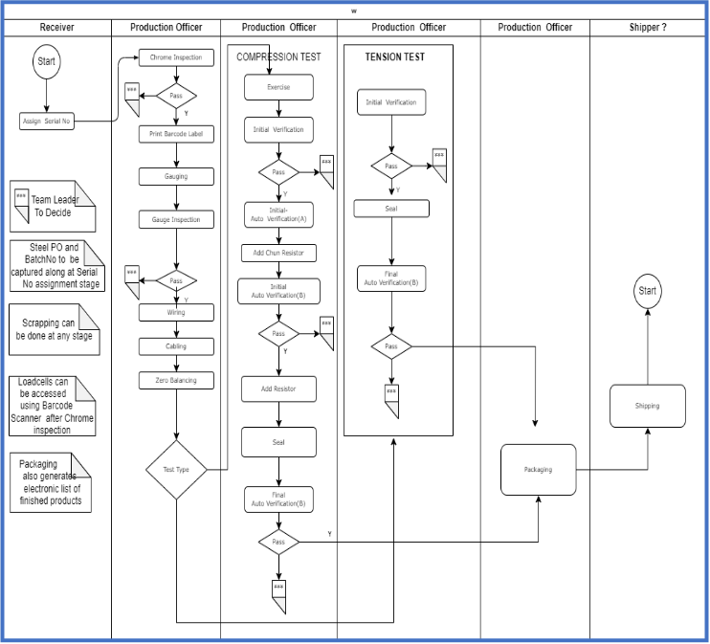
Production FLOW

Slide 31

REGISTRATION MANAGEMENT use case
Identify Yourself Please
Registration MANAGER
User Administration
You can only access these rooms

Slide 32
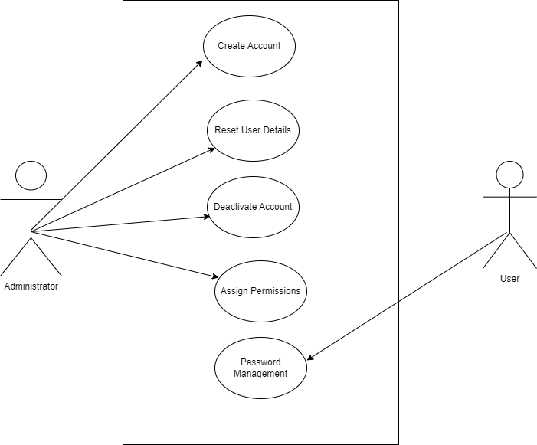
REGISTRATION MANAGEMENT

Slide 33
CASE 1
Registration User Creation
Use Case | Registration: Create Account
Actors | Administrator
Tasks | Create user name Select a role for user System generates default password for user Assign permissions to user

Slide 34
CASE 2
Reset User Details
Use Case | Registration- Reset User Details
Actors | Administrator
Tasks | Select a user Update user record

Slide 35
CASE3
Deactivate Account
Use Case | Registration Deactivate Account
Actors | Administrator
Tasks | Select a user Deactivate account Update user record

Slide 36
CASE 4
Assign Permissions
Use Case | Registration : Assign Permissions
Actors | Administrator
Tasks | login Assign /remove permission Update user credential

Slide 37
CASE 5
User Password Management
Use Case | Registration: Password Management
Actors | User
Tasks | login Modify password Update user credential Note – This can only be done by the account owner

Slide 38
summary
……

Slide 39

QUESTIONS/ CONTRIBUTIONS

Slide 40


